Slide 1
Computational Thinking
Part 1
Notes:
Computational thinking allows us to take a complex problem, understand what the problem is and develop possible solutions.
We can then present these solutions in a way that a computer, a human, or both, can understand.
There are four key techniques (cornerstones) to computational thinking:
decomposition - breaking down a complex problem or system into smaller, more manageable parts
pattern recognition – looking for similarities among and within problems
abstraction – focusing on the important information only, ignoring irrelevant detail
algorithms - developing a step-by-step solution to the problem, or the rules to follow to solve the problem

Slide 2
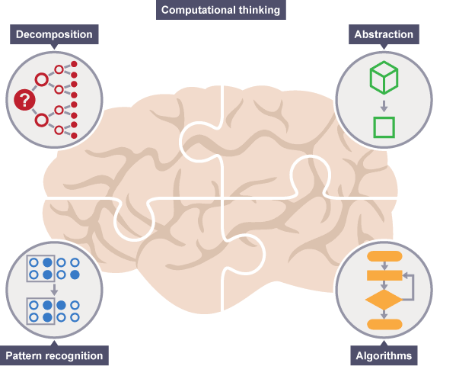
Today’s Topics
What is Computational Thinking?
Decomposition
Pattern Recognition
Abstraction
Algorithms
Notes:
Computational thinking involves taking that complex problem and breaking it down into a series of small,
more manageable problems (decomposition).
Each of these smaller problems can then be looked at individually,
considering how similar problems have been solved previously (pattern recognition) and focusing only on the
important details, while ignoring irrelevant information (abstraction).
Next, simple steps or rules to solve each of the smaller problems can be designed (algorithms).

Slide 3



Were you able to finish pre-class work for Computational Thinking?
Notes:
🍐 This is a Pear Deck Multiple Choice Slide. Your current options are: A: 👍, B: 👎,
🍐 To edit the type of question or choices, go back to the "Ask Students a Question" in the Pear Deck sidebar.
Hard or Easy
Use this template to do a quick temperature check and self-reflection about the homework. You can learn which students might have struggled with the assignment and therefore might need more attention today.

Slide 4

What is Computational Thinking?
Let’s discuss!
Come with an explanation in 5 minutes.
Notes:
Opinions of students on computational thinking should be discussed with the students.
They should try to predict what it might be. If they heard it before or new it before they should try to explain it to the rest of the class.
Instructor should also help them discuss by sharing opinions and guiding the class.

Slide 5
What is Computational Thinking?
Computational thinking is:
Logical thinking
Critical thinking
Problem solving
Notes:
Teacher will be explaining these parts in detail by giving example on them. And also should ask the students the way they use these stuff.
For example: Do you organise data?
Daily life examples.
Soccer match classification
Breaking problems into parts:
Cooking a dish
Cleaning your home
Orchestra (Everybody plays different instrument/ synchronization a great product)
What are patterns and models? Where do you encounter them?
After asking one or two questions about the sub headers and getting answers to them, these should be explained briefly.

Slide 6

If a problem is too hard, what should you try to do?
Notes:
Summarize
Have students write a quick, 1-2 sentence summary of the information they’ve just learned.
🍐 This is a Pear Deck Text Slide
🍐 To edit the type of question, go back to the "Ask Students a Question" in the Pear Deck sidebar.

Slide 7
Some Questions to Think About Before Starting
If you find similarities in lots of solutions to different problems what does that
probably tell you?
If you have a problem that is just a little different from a problem that you have a
solution for, what would you do?
Notes:
Introduced questions will be discussed with the students.
If any clue about computational thinking/ problem solving is recognized in the answers and opinions of the students that should be emphasized.

Slide 8
What is Computational Thinking?
Computational thinking is:
Organising data/information logically (Abstraction)
Breaking problems into parts (Decomposition)
Interpreting patterns and models (Pattern Recognition)
Designing and implementing algorithms (Algorithms)
Notes:
Teacher will be explaining these parts in detail by giving example on them. And also should ask the students the way they use these stuff.
For example: Do you organise data?
Daily life examples.
Soccer match classification
Breaking problems into parts:
Cooking a dish
Cleaning your home
Orchestra (Everybody plays different instrument/ synchronization a great product)

Slide 9
Challenge
Add all the numbers from 1 to 200
Big problem?
Did you try?
A lot to do in your head?
Notes:
In this part to understand how simple computers are compared to humans, students will take part in an activity called ‘’Battleships’’ where there will be introduced to a simple sorting algorithm. Instructions to the game are in the following link.
https://classic.csunplugged.org/wp-content/uploads/2014/12/unplugged-06-searching_algorithms.pdf
After completing this activity. The simplicity of a computer should be emphasized in terms of the way computers ‘’understand’’ human stuff.

Slide 10
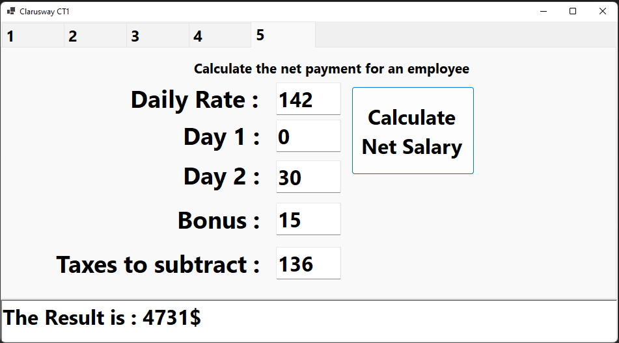
Challenge
Calculate the Salary for an employee

Slide 11
What is programming?
Notes:
Summarize
Have students write a quick, 1-2 sentence summary of the information they’ve just learned.
🍐 This is a Pear Deck Text Slide
🍐 To edit the type of question, go back to the "Ask Students a Question" in the Pear Deck sidebar.

Slide 12
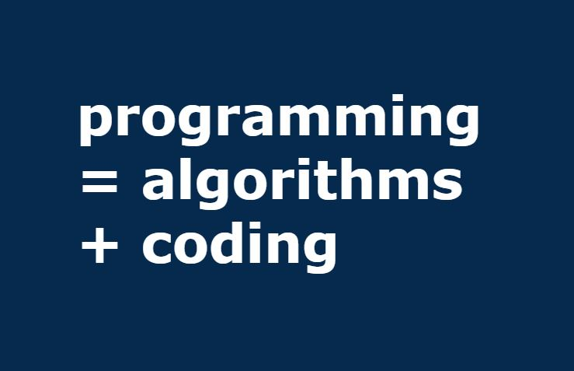
What is Computational Thinking?
Computational Thinking is the must step between having a problem and having a solution to that problem.
Computational Thinking aims to teach how to form a solution such that can be programmed into a computer.
Notes:
In this part computational thinking as a whole should be explained briefly to the students. Topic of how to explain/ program a solution into a computer can be discussed with the students.

Slide 13
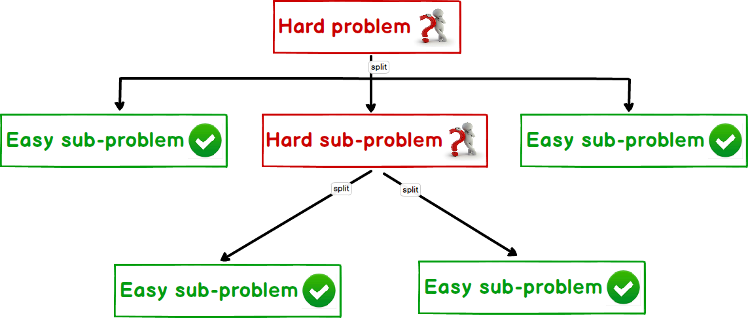
Decomposition
It basically means breaking a problem into smaller pieces.
Let’s think of some examples of decomposition!
Notes:
After the teacher briefly explains what decomposition students will try to give examples on applications of decomposition.
Teacher can help them by starting with the first example or by asking questions like
‘What kind of tasks do you do on a daily basis’’ and after getting the answer teacher can
ask the student if they can decompose that particular problem into smaller ones.

Slide 14
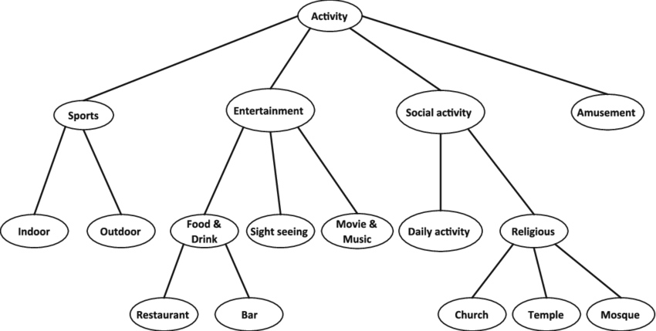
Decomposition
We use tree structures to visualize decomposition
Tree structures help us decompose problems into sub-problems.
It consists of blocks connected by branches.
Each block that is connected to its parent block which is above it, represents a sub problem of that block.
Notes:
Teacher will explain what a tree structure and can give an example of themselves if they want.

Slide 15
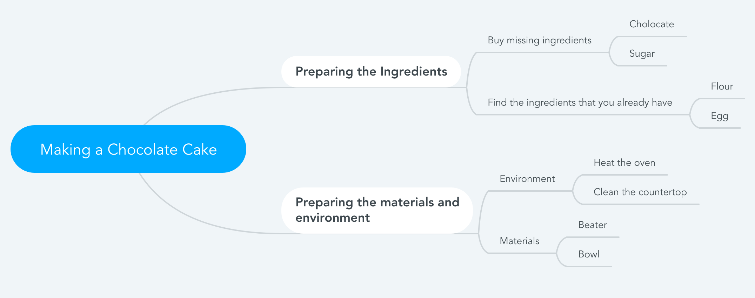
Making A Chocolate Cake

Slide 16
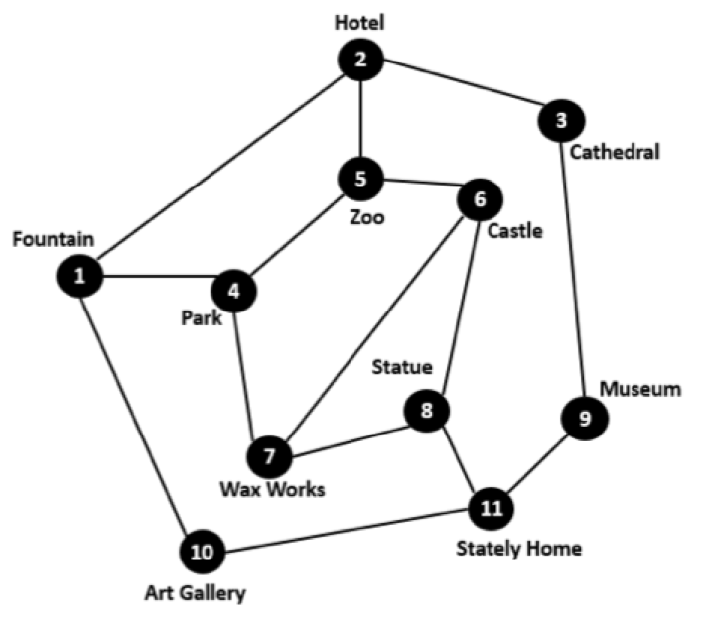
Decomposition Challenge
You are a tour guide. Tourists have booked a tour visiting all the city’s attractions starting from the hotel they are staying in. This map shows where the attractions are and roads that connect them. You must work out a route that takes your tour group to every tourist site. The tourists will not be happy if they pass through the same place twice. They also want to end up back at their hotel that evening.
Notes:
🍐 This is a Pear Deck Text Slide
🍐 To edit the type of question, go back to the "Ask Students a Question" in the Pear Deck sidebar.
In this part to understand how simple computers are compared to humans, students will take part in an activity called ‘’Battleships’’ where there will be introduced to a simple sorting algorithm. Instructions to the game are in the following link.
https://classic.csunplugged.org/wp-content/uploads/2014/12/unplugged-06-searching_algorithms.pdf
After completing this activity. The simplicity of a computer should be emphasized in terms of the way computers ‘’understand’’ human stuff.

Slide 17
Decomposition Challenge
You are a tour guide. Tourists have booked a tour visiting all the city’s attractions starting from the hotel they are staying in. This map shows where the attractions are and roads that connect them. You must work out a route that takes your tour group to every tourist site. The tourists will not be happy if they pass through the same place twice. They also want to end up back at their hotel that evening.
2, 3, 9, 11, 10, 1, 4, 7, 8, 6, 5, 2
Notes:
🍐 This is a Pear Deck Text Slide
🍐 To edit the type of question, go back to the "Ask Students a Question" in the Pear Deck sidebar.
In this part to understand how simple computers are compared to humans, students will take part in an activity called ‘’Battleships’’ where there will be introduced to a simple sorting algorithm. Instructions to the game are in the following link.
https://classic.csunplugged.org/wp-content/uploads/2014/12/unplugged-06-searching_algorithms.pdf
After completing this activity. The simplicity of a computer should be emphasized in terms of the way computers ‘’understand’’ human stuff.

Slide 18
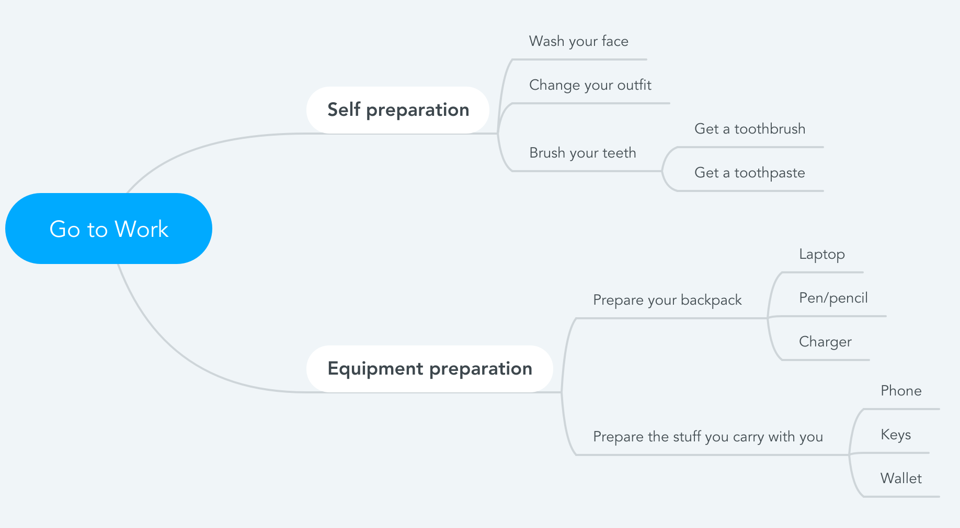
Preparing to Go to Work in the Morning
Notes:
Mind Map
Starting with a central idea, give students time to branch out their thoughts visually to help build connections.
🍐 This is a Pear Deck Drawing Slide
🍐 To edit the type of question, go back to the "Ask Students a Question" in the Pear Deck sidebar.

Slide 19
Preparing to Go to Work in the Morning
Notes:
https://www.mindmeister.com/?r=470018

Slide 20
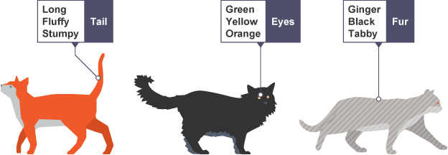
Pattern Recognition
Pattern recognition is recognising patterns in different things (solutions) and being able to apply these patterns in the solutions of other similar problems.
Pattern recognition is good because we don’t have to come up with a new solution each time we encounter the same problem. Instead, we apply the patterns that we have previously recognized.
Notes:
What will happen if we recognize patterns, we can convert them to classes.
Give an example of what the classes are, how we can implement them (maybe a test application?)

Slide 21
Pattern Recognition Exercises
Look at the following number patterns and find the sequence.
1 2 5 10 17 ?
Notes:
🍐 This is a Pear Deck Text Slide
🍐 To edit the type of question, go back to the "Ask Students a Question" in the Pear Deck sidebar.

Slide 22
Pattern Recognition Exercises
Look at the following number patterns and find the sequence.
1 2 5 10 17 26
Add 1, 3, 5, 7, 9 etc. to previous number

Slide 23
Pattern Recognition Exercises
Look at the following number patterns and find the sequence.
123 117 108 99 ?
Notes:
🍐 This is a Pear Deck Text Slide
🍐 To edit the type of question, go back to the "Ask Students a Question" in the Pear Deck sidebar.
-6 -11 -9

Slide 24
Pattern Recognition Exercises
Look at the following number patterns and find the sequence.
123 117 108 99 81
Subtract the sum of previous digits (1 + 2 + 3 = and 123-6 = 117)
Notes:
🍐 This is a Pear Deck Text Slide
🍐 To edit the type of question, go back to the "Ask Students a Question" in the Pear Deck sidebar.

Slide 25
Pattern Recognition Exercises
Look at the following number patterns and find the sequence.
849 352 768 493 527 __
Notes:
🍐 This is a Pear Deck Text Slide
🍐 To edit the type of question, go back to the "Ask Students a Question" in the Pear Deck sidebar.

Slide 26
Pattern Recognition Exercises
Look at the following number patterns and find the sequence.
849 352 768 493 527 684
The numbers are 84935276 repeated and then split into groups of 3 digits
Notes:
🍐 This is a Pear Deck Text Slide
🍐 To edit the type of question, go back to the "Ask Students a Question" in the Pear Deck sidebar.

Slide 27
Pattern Recognition Exercises
Look at the following number patterns and find the sequence.
12 48 163 26 412 ?
Notes:
🍐 This is a Pear Deck Text Slide
🍐 To edit the type of question, go back to the "Ask Students a Question" in the Pear Deck sidebar.

Slide 28
Pattern Recognition Exercises
Look at the following number patterns and find the sequence.
12 48 163 26 412 8
The spaces are incorrectly added, when they are correct it is a simple x 2 pattern
Notes:
🍐 This is a Pear Deck Text Slide
🍐 To edit the type of question, go back to the "Ask Students a Question" in the Pear Deck sidebar.
Remember TCP/IP protocol in CF? Packages received had no sequence?

Slide 29
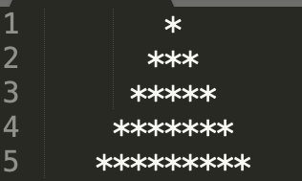
Pattern Recognition Exercises
Look at the following number patterns and find the sequence.
Notes:
🍐 This is a Pear Deck Text Slide
🍐 To edit the type of question, go back to the "Ask Students a Question" in the Pear Deck sidebar.

Slide 30
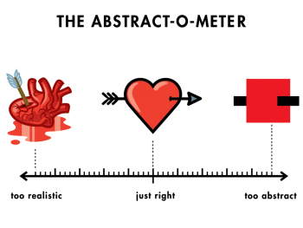
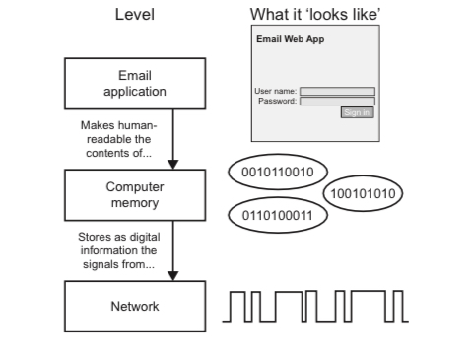
Abstraction
Abstraction is getting rid of the useless information that is not going to have any contribution to the solution.
Abstraction is the core concept of computer science and computational thinking. To be able to express a real world problem to a computer, the problem has to be abstract.

Slide 31
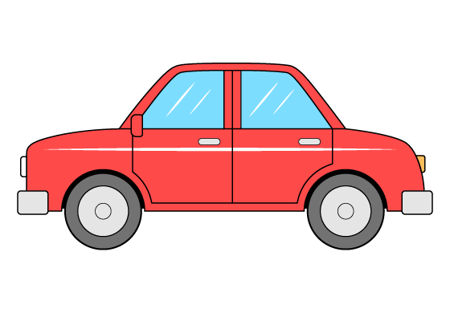



Let’s abstract stuff!
The key part of abstraction is ignoring the useless aspects of something and including the beneficial aspects. So, find out the useless aspects that are going to be ignored and the beneficial aspects that are going to be considered of the items below. Try going abstract as far as possible. (For example a house is nothing but a shelter for humans when you look abstractly)
Car
Pencil
House
Mobile phone
HINT: Think of what do these objects help solving and which aspects of them wouldn’t prevent them from solving that particular problem.
Notes:
🍐 This is a Pear Deck Text Slide
🍐 To edit the type of question, go back to the "Ask Students a Question" in the Pear Deck sidebar.

Slide 32
Let’s Abstract Stuff!
The abstractions should look something like this:
Object | Include | Ignore
Car | Engine, tires, rims, seat | Color, shape, trunk, radio
Pencil | color of the tip, grip | material, brand, type
Mobile phone | speaker, microphone,cellular | color, brand, camera

Slide 33
Algorithm Design
4

Slide 34
Brief Explanation of Algorithm
An algorithm is a sequence of clearly defined steps to describe a process.
Algorithms are useful when we wish to explain someone else or a computer how to carry out steps.
Algorithms are important for programming because a correct algorithm is the ultimate basis of any computer-based solution.

Slide 35
Let’s brew a coffee
?
Notes:
🍐 This is a Pear Deck Text Slide
🍐 To edit the type of question, go back to the "Ask Students a Question" in the Pear Deck sidebar.

Slide 36
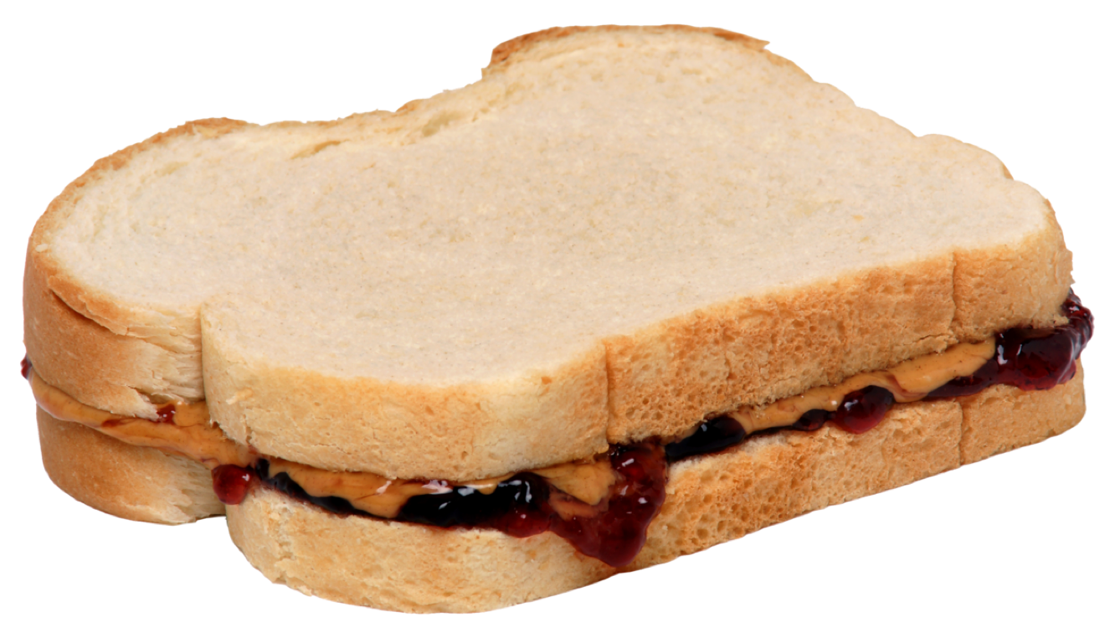
Exact Instructions
Notes:
https://www.youtube.com/watch?time_continue=1&v=cDA3_5982h8&feature=emb_logo

Slide 37
Let’s take attendance
1 stand up
2 assign yourself the number 1
3 until only one person remains standing
4 pair off with someone else standing
5 add your numbers together
6 assign yourself the new number
7 choose one member of the pair to sit
8 if you are chosen
9 sit down and do nothing else
10 if you are standing
11 report your number

Slide 38
How computers sort?
6 4 5 2 1 3
Notes:
Bubble Sort, Insertion Sort, Selection Sort, Divide and Conquer Sorting, Prepare a basic application that sorts the numbers given …
"""
Sorting a list of integers in Python, negative-positive ignored.
"""
def Bubble_Sort(array):
# Outer loop
for i in range(len(array)):
# Inner loop
for j in range(0, len(array) - i - 1):
# compare two adjacent elements
if array[j] > array[j + 1]:
temp = array[j]
array[j] = array[j+1]
array[j+1] = temp
data = [-2, 45, 0, 11, -9]
Bubble_Sort(data)
print('Sorted :')
print(data)

Slide 39
Real Industrial Application? APP1
There are RF communicating devices on the field, Electricity and Watermeters. They are around 11000pcs. Every collector receives signals without collision for about 800pcs.
Notes:
How will
https://thingslog.com/blog/2020/04/09/practical-iot-training-on-lora-and-lpwan/
Extend the features;
Integration LoRa Server,
Integration with the local system.
Backend-Frontend application.
Customer definitions.
ORM.
Which DB would be ok?

Slide 40
Real Industrial Application? APP-2
There is a small scale application where 1300 RF enabled water meters. Water Meters are installed in some cases inside the house, some cases out of it. You have around %97 coverage. Develop a mobile application to collect the
readouts. Transfer the collected data to the server, integrate with their system with REST Json Service.
Notes:
Search “ism band 868 mhz wireless MBus rf reader mobile device” in google.

Slide 41
Real Industrial Application? APP-3
Create a complete solution for a smart card implementation.
Notes:
The credits inside the card is critical.
The reports are important for the customer.
Customer needs no integration with the local system. They will use your solution.
Mifare Plus cards will be used in the system for a higher security comparing to Mifare Classic.

Slide 42

THANKS!
Any questions?
You can find me at:
@volkan
volkan@clarusway.com
Notes:
🍐 This is a Pear Deck Text Slide
🍐 To edit the type of question, go back to the "Ask Students a Question" in the Pear Deck sidebar.

